Slide 1
2019 NSF RET Project
Modeling of Signalized Intersection Design and Impacts
Example
Pre-Timed Signal Design
Actuated Signal Design

Slide 2
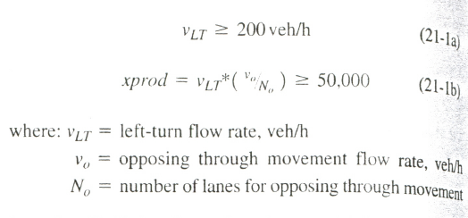
Pre-Timed Signal Design
Left Turn Requirement

Slide 3
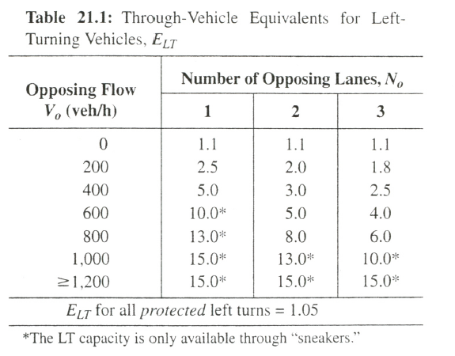
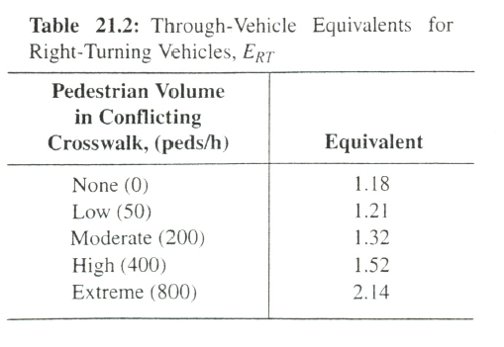
Turning Equivalents

Slide 4
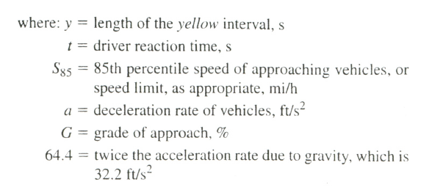
Yellow Interval

Slide 5
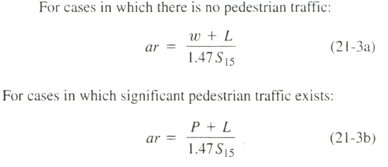
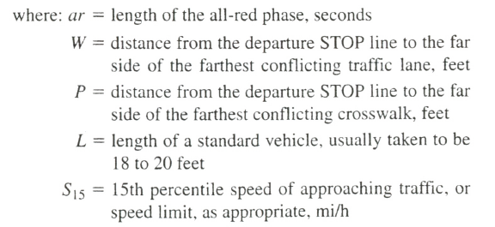
All Red Interval for each Phase

Slide 6
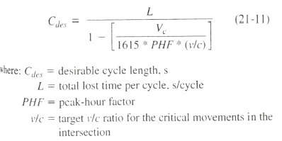
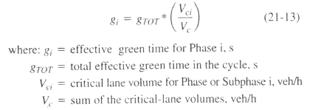
Cycle Length
Effective Green Total = C – L
Effective Green per Phase

Slide 7
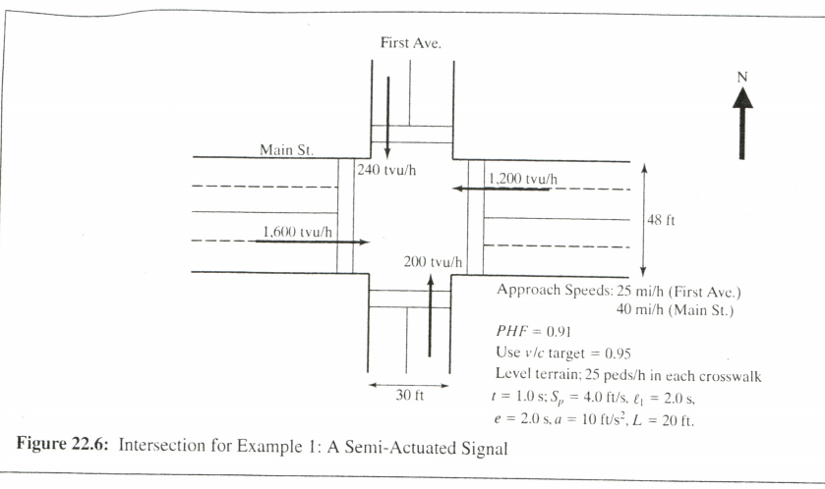
Actuated Signal Design
Example 22-1
Fig 22.6 shows an intersection that will be signalized using a semi-actuated controller. For convenience, the demand volumes shown have already been converted to through vehicle units

Slide 8
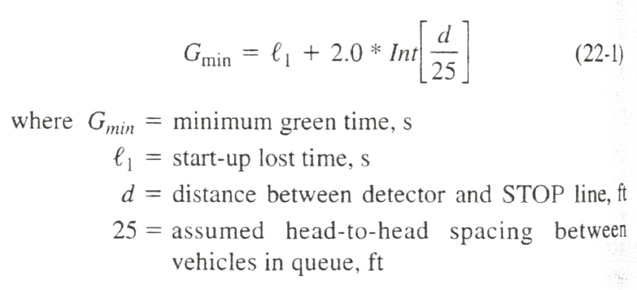
Step 1 : Phasing
Phase 1 – Minor Street Movements
Phase 2 – Major Street Movements
Step 2 : Minimum Green Time and Detector Location

Slide 9
Step 3: Passage Time
Minimum Passage Time: Regardless of type of detector being used, the passage time has a minimum value based on the location of point detector or the front edge of a presence detector.
Step 4: Sum of Critical-Lane Volumes
Volumes are to be converted into through vehicle equivalents and critical-lane volume for each phase are to be calculated.

Slide 10
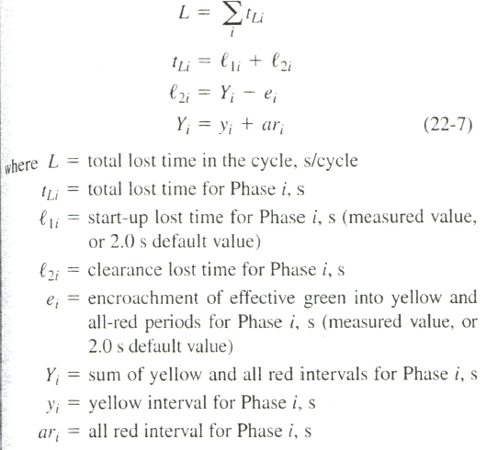
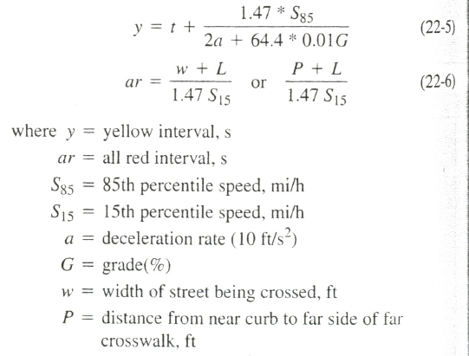
Step 5: Yellow and All- Red Times and Total Lost Time

Slide 11
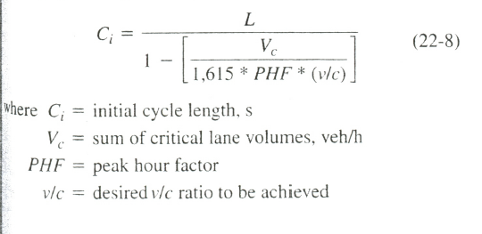
Step 6: Maximum Green for Major Street and Minimum Green for Minor Street
Initial Cycle Length
Effective Green Time
Final Cycle Length = Total Green Time +Total Yellow time + Total All Red Time

